Slide 1
User Accessibility Testing
Nirgun Amin
Karan Patel

Slide 2
Objective
Our team was assigned to conduct usability testing for a software-as-a-service (SAAS) application designed for healthcare systems that will be used by the people they serve. The New Jersey Department of Health and Human Services has made it clear that the health and well-being of the individuals they serve is their main priority. Therefore, our task was to test the usability of the application and ensure that it provides convenience for its users.

Slide 3

HIPAA Compliance
What is HIPAA (Health Insurance Portability and Accountability Act)?
Companies that retain medical information that is electronically identifiable are required by law to take precautions to secure their data infrastructure.
HIPAA Compliance
Tested through security mechanisms and inner workings.
Potential vulnerabilities (accomplished through pen-testing)

Slide 4
Penetration Testing
Lasting security is impossible
Ethical hacking
Pen-testers authorized to compromise a company's network.
Tests for vulnerabilities
Reports about findings
Future plans for security

Slide 5
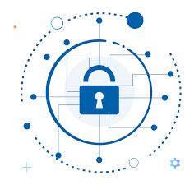
Testing Security Features
Sign up / Login concerns
Require security questions and strong passwords
Several attempts
Change password
Notification of login attempts
Through email
Timeout feature
X minutes of inactivity

Slide 6
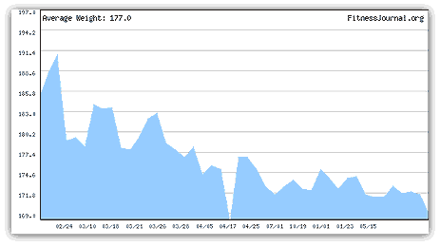
Basis Patient Information
A patient’s basic information builds a strong foundation in making the app personalized
E.g. Weight, Date of Birth, Height
A user would able able to track their statistics over time, such as weight and vitamins
As shown in the example figure to the left, weight changes are shown on a graph to allow a patient to see their changes visually

Slide 7
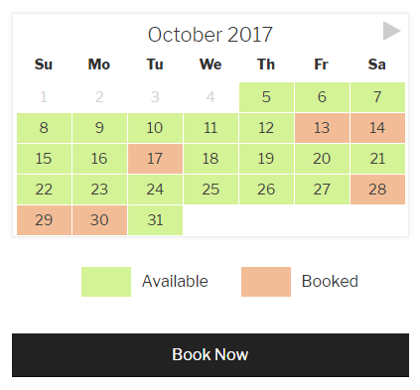
Appointments through the App/Site
A patient would also be able to easily make appointments through the app/site
have the ability to reschedule, and view availability
Payment methods may also be added, to pay for services, co-pay and other fees online
creates ease for employees scheduling appointments, as this reduces phone traffic, and creates a linked system that can be viewed remotely as well

Slide 8
Patient Records
Lab Reports:
Lab reports could be sent to the patient directly via app
Medication List
A patient can view medication history as well as current medical plan
Patient Health Education
Educate patients about different health conditions they might want to know more about

Slide 9
Desktop version
Desktop version is just the clone of the app with more advanced reporting and analytics.
With the desktop version:
user of a larger range of ages can access their information
security is stronger on the desktop version , for those concerned about safety

Slide 10
Reward System
Patients can be rewarded for performing activities such as at-home exercises, arriving on time for all scheduled appointments, following to their treatment plan, attending annual mandatory check-ups.
Patients' health will be taken into consideration when determining the reward.
The reward system will be based on a point system, and patients will be needed to reach the required number of points in order to receive the reward.
Increases incentive for downloading the app

Slide 11
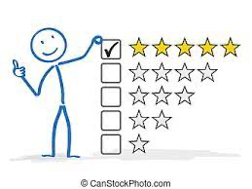
Rate and Review
Patients can rate doctors through the app without any worry because their identities will not be revealed to doctors.
Patients can choose their doctor based on the rating and reviews that have been written about them.
Tested by making sure the reviews appear online

Slide 12
Health Insurance Provider
Patients can easily apply for insurance through app or desktop version
Patients can also make appointments with healthcare providers for deeper conversation
In order to demonstrate to patients what benefits each insurance provider is offering, annual exhibitions will be held on the app.
Patients can click on insurance providers profile to see the benefits.

Slide 13

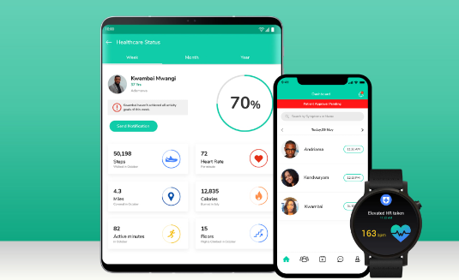

Basic Patient Information
Information from latest checkup
Appointments Section
Payment Method
Medical Reports/Treatments

Slide 14
We want your feedback!
Are the features easy to use?
Do you feel this software is secure?
Any other concerns?
While we do test our apps for months prior to the release date, we need the opinions of those that matter most - our users. Please fill out this quick survey to let us know where we can improve.
The survey can be found at https://usabilitytesting.com/appfeedback.
Not easy
at all
Moderately
easy to use
Very easy to use
Not secure
Moderately
secure
Very secure

Slide 15
Resources
https://www.brainspire.com/blog/how-to-check-if-your-companys-software-is-actually-hipaa-compliant

